Slide 1
A brief introduction to Knowledge Graphs
Deepankar Sharma

Slide 2
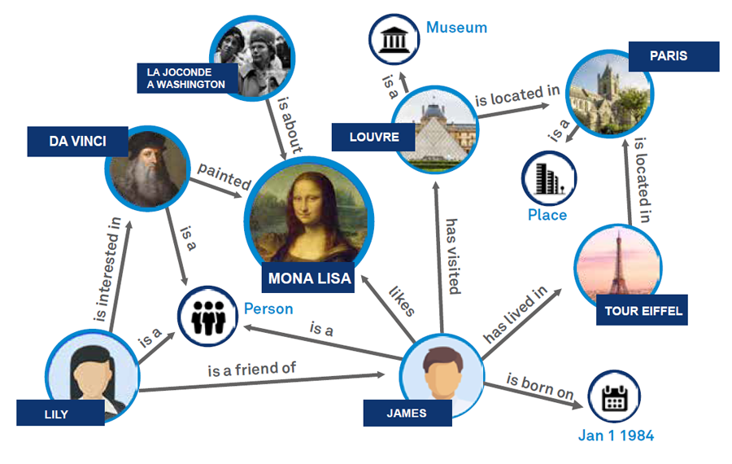
Understanding Knowledge Graphs
A Knowledge Graph is a structured representation of knowledge that captures entities, their attributes, and relationships between them.
Knowledge Graphs play a crucial role in enhancing search engines, recommendation systems, and various other applications.
Deepankar Sharma

Slide 3
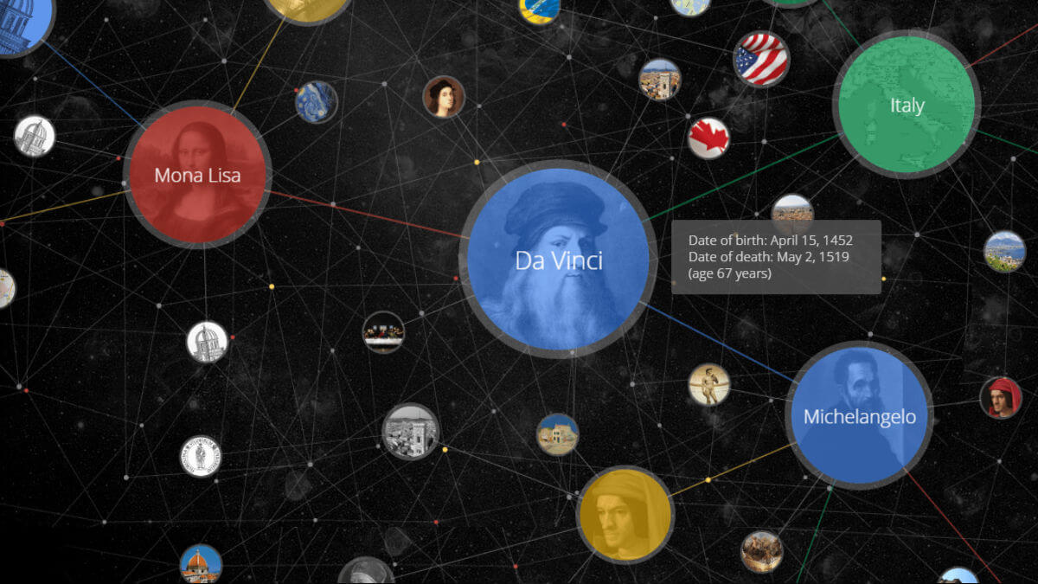
The
Google
Knowledge
Graph
Deepankar Sharma

Slide 4
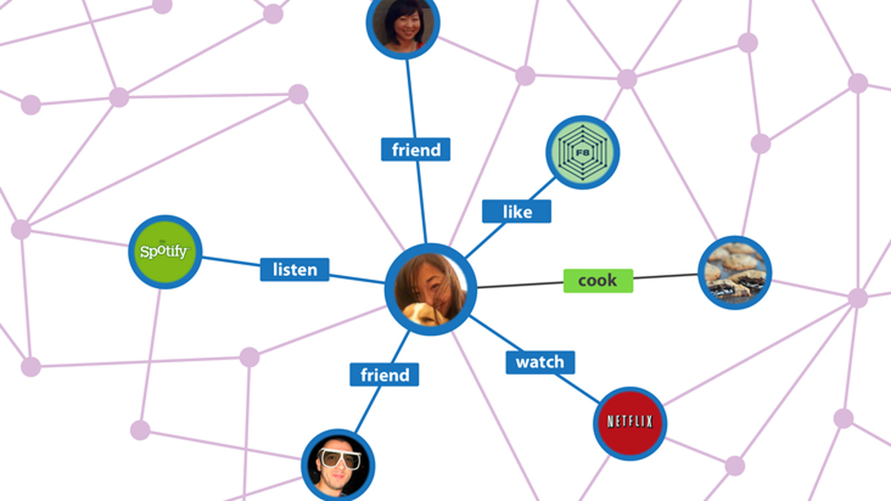
The
Facebook Knowledge Graph
Deepankar Sharma

Slide 5
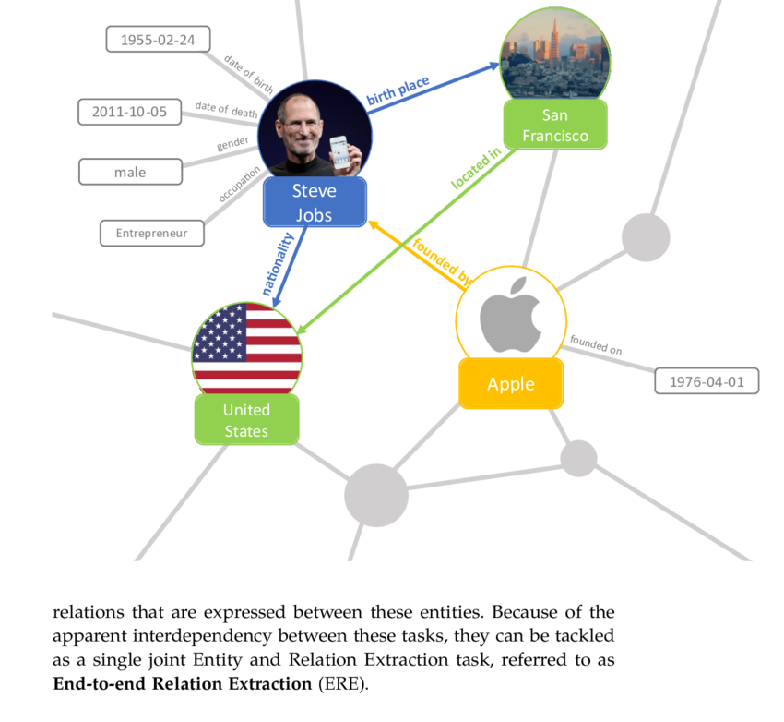
Key Components
Nodes: Entities represented in the graph, such as people, places, or concepts.
Edges: Connections or relationships between nodes, providing context and meaning.
Properties: Attributes or characteristics associated with each entity, adding depth to the representation.
Deepankar Sharma

Slide 6
Constructing a Knowledge Graph
Data sources: Gathering information from diverse sources such as databases, text, or web scraping.
Entity extraction: Identifying entities from the collected data using techniques like Named Entity Recognition (NER).
Relationship extraction: Determining and establishing connections between entities to create meaningful relationships.
Deepankar Sharma

Slide 7
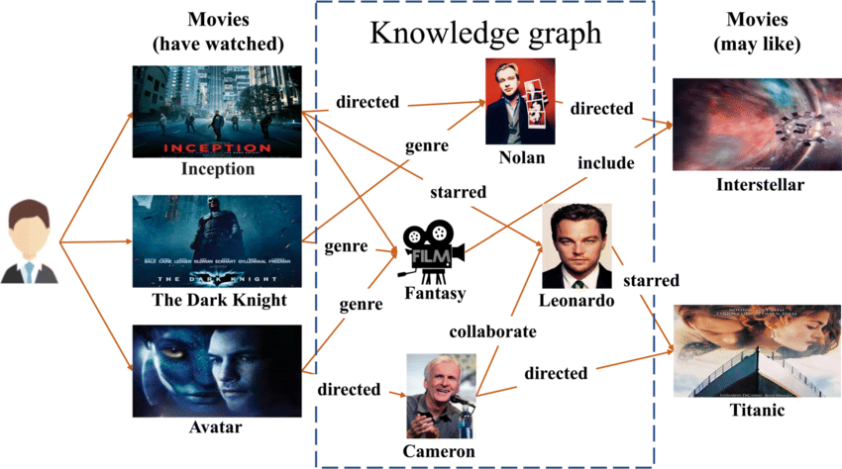
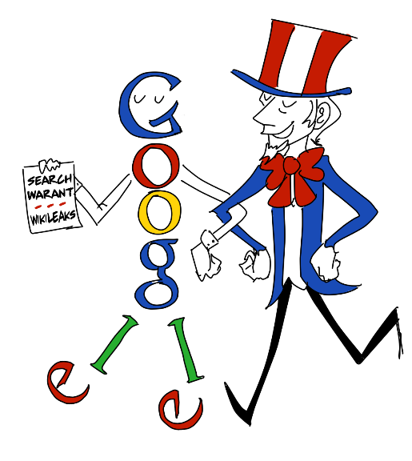
Applications in Real-World Scenarios
Semantic search: Enhancing search results by understanding the context and relationships between keywords.
Recommendation systems: Suggesting relevant content or products based on user preferences and connections in the graph.
?
Deepankar Sharma

Slide 8
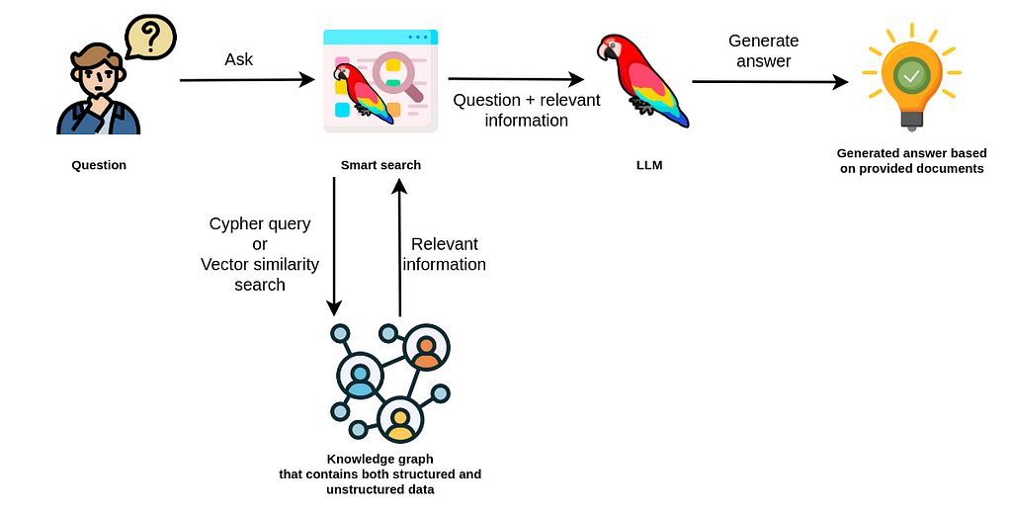
Integration with LLMs & RAG
Deepankar Sharma

Slide 9
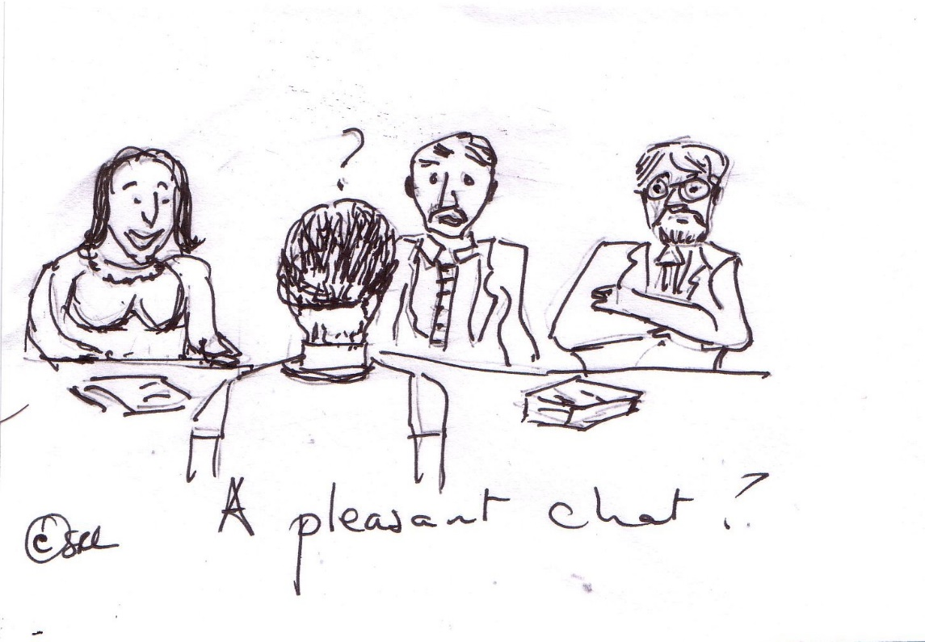
Overcoming Hurdles
Data quality: Ensuring accuracy and reliability in the information within the Knowledge Graph.
Scalability: Handling and processing large volumes of data to maintain efficiency.
Privacy: Implementing measures to protect sensitive information and adhere to privacy regulations.
Deepankar Sharma

Slide 10
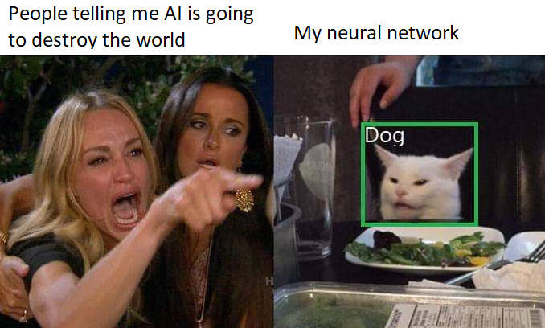
Responsible AI
Deepankar Sharma

Slide 11
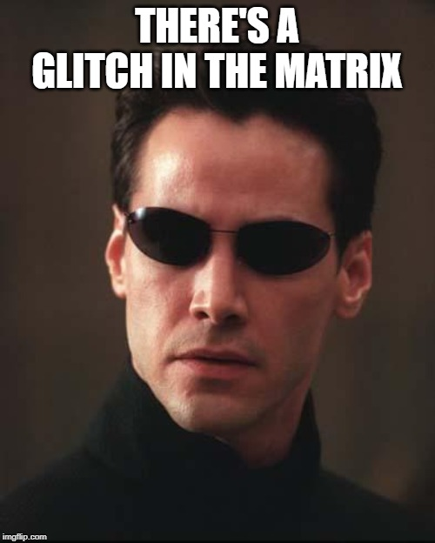
Looking Ahead
Recap: Knowledge Graphs serve as a powerful tool in organizing and leveraging information for various applications.
Ghar Ja ke?? ….
Ontology ,CQL, SPARQL, rdf,
svo triplets, Neo4j, ……
Future trends: Explore ongoing advancements, such as the integration of AI and machine learning in Knowledge Graphs.
Deepankar Sharma

Slide 12
Thank You !
Deepankar Sharma

